Slide 1
METADATA MANAGEMENT & PHYSICAL DESIGNING

Slide 2

METADATA MANAGEMENT
Why Metadata Management ?
It has slowly become one of the most important practices for a successful digital initiative strategy. With the rise of distributed architectures such as Big Data and Cloud which can create siloed systems and data, metadata management is now vital for managing the information assets in an organization.
Mentored Seminar on Metadata Management & Physical Designing
By PIYUSH CHANDRA CHANDRA
SOURABH KANGSA BANIK
Notes:
Sourabh: First of all i would like to say that if anyone wants to choose DBMS as their career should definitely understand this Metadata Management.

Slide 3
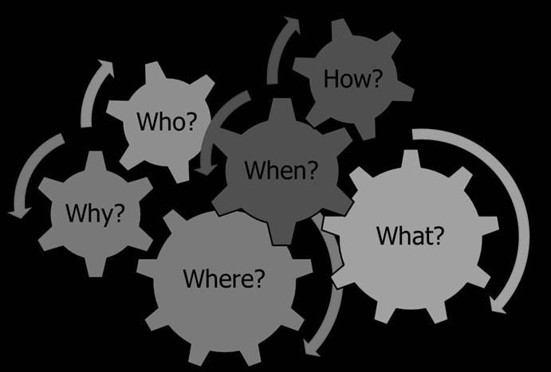

Metadata Management is the Core functionality is enabling a business user to search and identify the information on the key attributes in web-based user interface.
For example, consider the index of any book or novel; it serves as the metadata that leads us to the detailed data inside the book.
Introduction to Metadata Management
Metadata is the data, or information, about the data.
Notes:
Piyush: So now lets just understand deeply what is Metadata management. The word ‘meta’ is a prefix that in most information technologies uses which means definition or description so we can say metadata is the summarized data for the contextual data. It describes the proactive use of metadata to govern data in a way that ultimately supports well informed business decisions and efficiency. Meatdata Management Metadata is the data, or information, about the data. Lets understand with a example of a book we do have a index page where we can get all the details of the book basically this is the index of an organization.

Slide 4
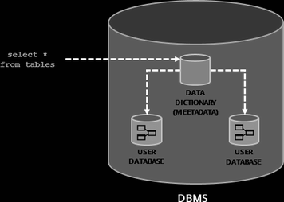
What is Metadata?
In a database, information is organized and stored in a structure. This data is arranged in tabular form (rows and columns) so that it can be accessed and reorganized quickly. After the structural arrangement of data, each part has its metadata as an index number in a book for each chapter. This index number is known as the metadata that defines the schema for other data.
Notes:
Sourabh: Now how metadata is used in Dbms?So let’s have a look
Metadata in DBMS refers to the information that describes the schema and other information related to the stored data in the database, including storage, programs, data elements, usage, and additional related information.

Slide 5
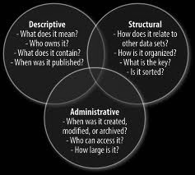
Types of Metadata in DBMS:
Schema
Tables
Columns
Constraints
Indexes
Sequences
Storage
Table size
Data type size
Variable size
Program size
Number of rows and columns
Physical Execution
Backup files
Partitions
Restored files
Notes:
Piyush: Descriptive Metadata is what we normally think of as content modeling. This is metadata that describes an object – the properties that define what it is: title, body, author, etc. Administrative Metadata is not something that the public consumes, but rather someone that is used to manage the object. publish date, expiration date, rights management, etc. Structural Metadata is what I would call “relational content modeling." This is the information that relates this content to other content, and makes it possible for this content to fit into larger structures, and provides functionality https://deanebarker.net/tech/blog/three-types-of-metadata/
metadata standard or schema is: a labeling, tagging or coding system used for recording cataloging information or structuring descriptive records.It depends on multiple factors Metadata is what the data in a file or sector header is in a storage device or system.It depends on multiple factors similarly in physical execution it depends on real time problems like

Slide 6
How Metadata plays a significant role in DBMS:
Metadata in DBMS refers to the information that describes the schema and other information related to the stored data in the database, including storage, programs, data elements, usage, and additional related information.
Metadata is essential for maintaining historical records of long-term data sets, making up for inconsistencies that can occur in documenting data, personnel and methods. Comprehensive metadata can also enable data sets designed for a single purpose to be reused for other purposes and over the longer term.
Metadata has a significant role in the database. Besides, it acts as a directory in the database for accessing the different files. Further, metadata can also be useful in many ways, like database reporting, auditing, querying, and transforming. It plays a crucial role in DBMS.
Notes:
Sourabh:Metadata in Dbms can be defines as the schematic diagram of various information that is stored in the database including various things like

Slide 7
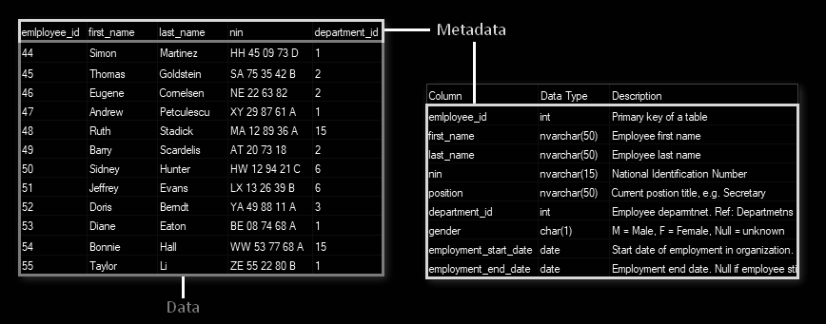
Example of Metadata Management
This metadata holds the following information:
Tables (rows and columns)
Data Types
Values
Table relationships
Constraints
Others
As you can see in the above image, a relational database stores the data as well as metadata in a structured way. The data stored in a structured way is called the Data Dictionary or System Catalog. Further, through this information, it’s easier to access or identify any database.
Notes:
Piyush: So as we can see in this example that a relational database stores the data as well as metadata in a structured way, this storing of data in a structured way is called the Data Dictionary or system catalog which holds the information in row and column manner like: the data types, values, the relationship between tables, constraints and many more
Sourabh:

Slide 8

Accessibility of Metadata
Metadata enables user to search their own:
Geographic Information System (GIS)
Database Management System (DBMS)
Data Management System
Metadata enables user to search external:
Data Catalogs
Data Servers
Web-mapping Applications
Data Distribution System
Notes:
Piyush: So now you must be assuming that how the data can be accessed? Let me clear that metadata tools allow both searching techniques as the user may search by their own as well as may search externally. It helps to organize, find and understand data.
Sourabh: A geographic information system (GIS) & DBMS is a framework for gathering, managing, and analyzing data.
A distributed database system is an integrated collection of databases that is physically distributed across sites in a computer network.

Slide 9

Practical use of Metadata Management with example
HEADACHE
Suppose we are running a medicine shop where a large number of medicines are placed in wreck all around the stores. When a buyer come and ask for a medicine the owner finds it within a minute from the large stock.
So how did he find the medicine within a minute?
The answer is each and every medicine are categorized and indexed separately so that he can move to that place directly.
SARIDON
VICKS
ZANDU BALM
Notes:
Sourabh:

Slide 10
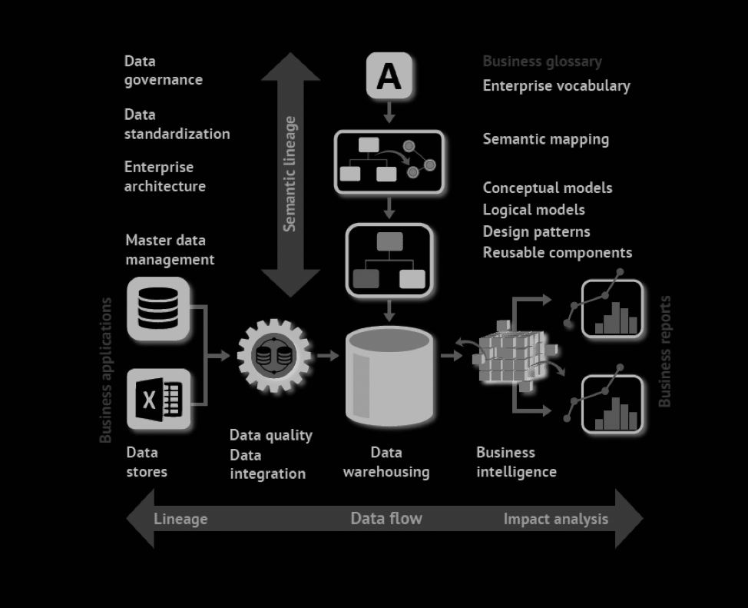
Metadata working principle
Tools like Talend Metadata Manager provide an automated way to parse and load different types of metadata. The tool also enables to build an enterprise model based on the metadata generated from different systems such as your data warehouse, data integration tools, data modelling tools, etc.
Notes:
Piyush: So today with the growing demand there are a lot of metadata management softwares which helps to parse or resolves and load different types of metadata.
If an organization have a completely built metadata management model then they may experience a 360 degree view on how different systems in that organization are connected together. This will also allows that organization to create a custom metadata types to stitch metadata between two systems which is a great advantage.
We do also have some metadata management systems which the reputed companies are using such as Informatica, IBM who delivers a comprehensive, unified view of metadata, business context, tagging, relationships, data quality, and usage.

Slide 11

How to keep Metadata Updated:
Just like any other Data Governance initiatives, as the metadata in individual systems change, the model needs to be updated following a SDLC methodology which includes versioning, workflows and approvals. Access to the metadata model should also be managed by creating roles, privileges and policies.
Notes:
Sourabh:

Slide 12


PROS
CONS
The major drawback of metadata is that there are too many metadata standards.
New metadata standards often include a subset of the old standards; this same information can be stored in different metadatas. Because new metadata standards emerge gradually, not all software programs support the latest metadata standards.
Metadata management is critical to the objectives of data governance, which include lowering the cost of data ownership, reducing legal and compliance risk, and improving business intelligence and operational effectiveness.
The chief benefits are greater operational effectiveness, more insightful long-range planning, and greater ease to comply with legal discovery and regulations.
Notes:
Piyush:Pro,
Sourabh:con

Slide 13
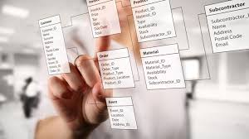
Physical Database Designing
Physical database design is the process of transforming a data model into the physical data structure of a particular database management system (DBMS).
Notes:
Sourabh: Physical database design is the process of transforming a data model into the physical data structure of a particular database management system (DBMS). There is actually four levels in the database designing…..so before physical database there is a level of logical databse...so there is a conversion of logical databse into physical databse.Its basically means the expanding of a business model into a fully attributed model and then transforming the fully attributed model into a physical design model

Slide 14
Physical Database Designing
DATABASE DESIGN PROCESS
COMPONENTS OF PHYSICAL DATABASE DESIGN
LOGICAL DATABASE STRUCTURE
DATA VOLUME AND USAGE ANALYSIS
USER PROCESSING REQUIREMENT
ESTIMATE SIZE OF DATABASE
SELECTING PHYSICAL STORAGE DEVICE
ESTIMATE COST OF STORAGE
SIZE
RESPONSE TIME
SECURITY
DATA DISTRIBUTION STRATEGY
BACKUP
DISTRIBUTED COMPUTING NETWORKS
NODE IN THE NETWORK
PHYSICALLY LOCATE THE DATA
PROPERTIES OF DBMS
Notes:
So there are three important inputs of Database Design Process

Slide 15
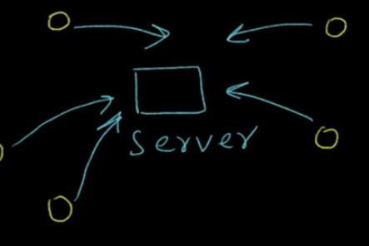
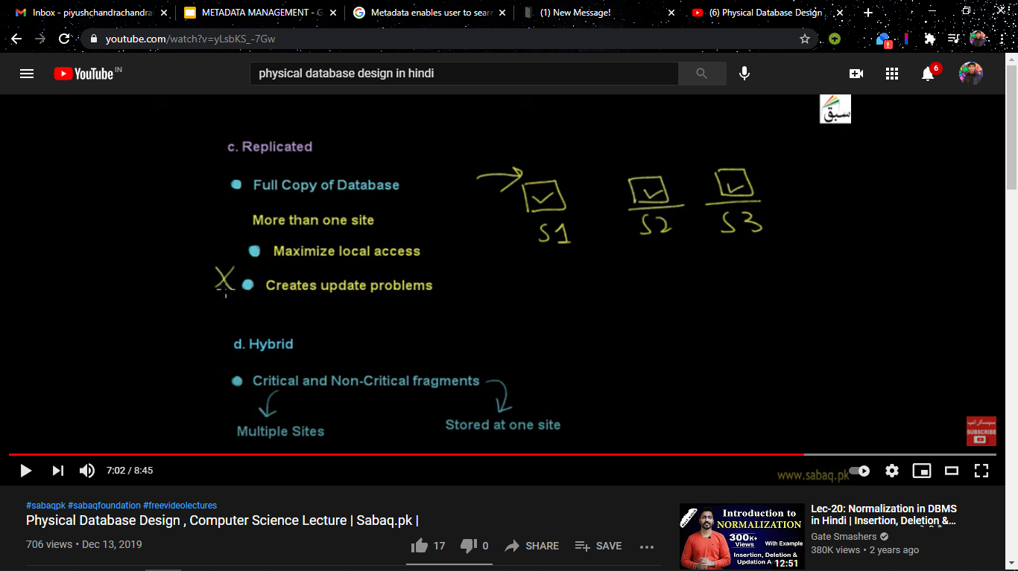
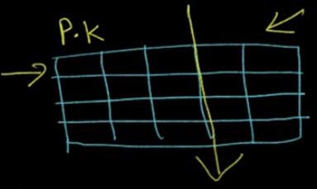
Physical Database Designing
BASIC DATA DISTRIBUTION STRATEGY
CENTRALIZED
DATA LOCATED AT SINGLE SITE
DATA COMMUNICATION COST HIGH
WHEN CENTRAL SYSTEM FAILS DATABASE SYSTEM WILL ALSO FAIL
PARTITIONED
DATABASE DIVIDED INTO PARTITIONS
MORE ACCESSIBLE
REPLICATED
MORE THAN ONE SITE
MAXIMIZE LOCAL ACCESS
HYBRID
CRITICAL FRAGMENT - MULTIPLE SITE
NON CRITICAL FRAGMENT - ONE SITE
Notes:
Sourabh: So the Data Distribution Strategy includes the centralised data distribution system is the basic data distribution strategy and it is also the most inefficient one how it works? It actually have a parent system or server from which all the users access data. In this
Replicated:So,in replicated one one parent data server is cloned into multiple servers and works like the local host access the local server.points:
Hybrid:So,in this distribution system the a table is being created and it has been partioned where one is critical and another is non critical fragment.So the critical one contains the primary key which can be access from multiple sites and in non critical fragment it cannot be accessed by any other server but the parent one.

Slide 16
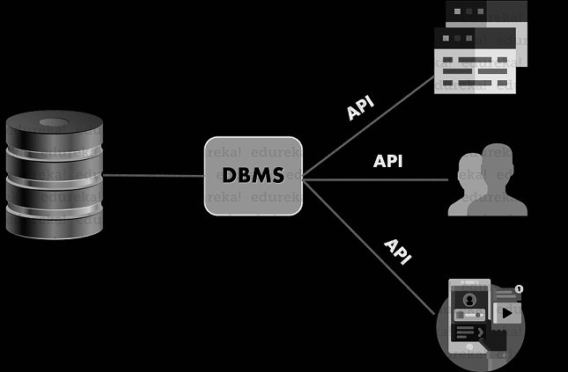
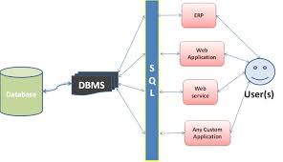
User Registration Interface:
USER REGISTRATION USING PHYSICAL DATABASE DESIGN
Notes:
Piyush:Suppose a user wants to access the website then he/she have to cross a authentication level to access the contains of the website.It is designrd in such a way that the user will first enter to a page or the user interface where he or she have to register themselves with a unique username and a strong password.And then when the user wants to visit the website he or she will be asked to enter their unique username and password which the dbms will verify the information from the database if it gets matched then he/she will be able to view the content.So there are certain levels for the user authentication,where physical databse designing plays a crucial role,where user have to access the server to get verified for the information that he/she had entered. So as we can see in this diagram that a user and the dbms communicates via an Application Programming Interface (API), Where the languages like MySql,Oracle helps to make the Database understand or verify.

Slide 17

Thank You

